Slide 1

By Clara Biles

Slide 2

Monarchs
Monarchs are butterflies with distinctive orange and black wings with white spots.
Since Monarchs have this color they stick out from normal scenery, meaning that predators come after them.
To prevent being eaten, the caterpillar eat milkweed. Milkweed has a toxin that is poisonous to the Monarchs predators.
Monarchs can’t fly if their body temperature is less than 86° Fahrenheit They will sit in the sun until they are warmed sufficiently or they will “shiver” to warm up.

Slide 3
Migration
Monarchs Migrate yearly. They migrate from the most northern part of North America down to Mexico.
Their migration usually takes three generation to complete.
They usually travel around 3,100 miles per migration cycle.
On average, Monarchs fly 50-100 miles a day.
Monarchs average flight speed is about 3 or four mph, but they can reach 12 mph!

Slide 4
Migration
Around thirty five million Monarchs migrate each year.
About 40-50% of Monarchs die during their migration.

Slide 5
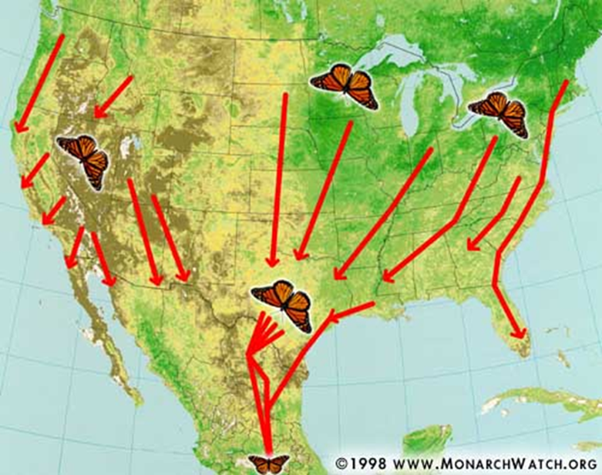
Maps
This is the Monarch migration path from 1998. Over the years the path has altered slightly. Now, the butterflies migrate through the west coast and east down to Mexico.
There are some that go down through
the plains and through Texas so that
they can get to Mexico. Milkweed is
essential to a monarchs survival. If
there wasn’t any milkweed in or near
the migration path then the monarchs
cant feed and they will end up dying.
This is a map of their migration route.

Slide 6
Ways in include math
Word Problems
Slope
Charts
Graphs

Slide 7
Examples
Word problem:
If a butterflies average speed is about 3 miles per hour and their migration is 3100 miles, how many days will it take to fully migrate?

Slide 8
Word Problem Answer
If a butterflies average speed is about 3 miles per hour and their migration is 3100 miles, how many days will it take to fully migrate?
About 43 days

Slide 9

Examples
Slope:
Each stem on a milkweed has about 10 leaves. A 4 foot tall milkweed this size will feed only 5 Monarch caterpillars. Each monarch caterpillar will eat 20 or more large leaves.
40
35
30
25
20
15
10
5
Number Of Monarchs
0 1 2 3 4 5 6 7 8
Number Of Milkweeds

Slide 10



Slope Answer
Slope:
Each stem on a milkweed has about 10 leaves. A 4 foot tall milkweed this size will feed only 5 Monarch caterpillars. Each monarch caterpillar will eat 20 or more large leaves.
Answer:
40
35
30
25
20
15
10
5
Number Of Monarchs
0 1 2 3 4 5 6 7 8
Number Of Milkweeds

Slide 11
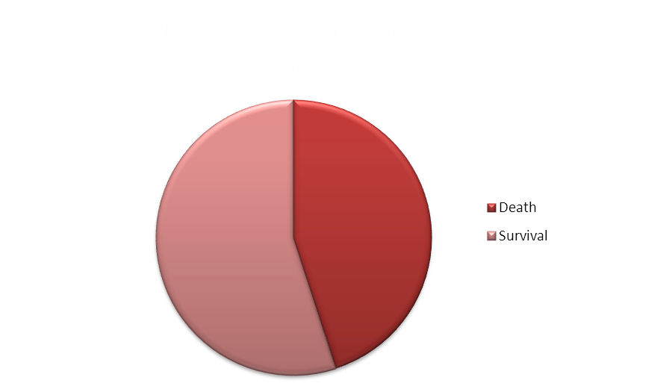
Graph
45%
Death
55%
Survival

